Slide 1
Architecture Evaluation

Slide 2
Topics
Evaluation Factors
Architecture Tradeoff Analysis Method (ATAM)

Slide 3
Musings on Architecture
What makes good architecture? What separates good architecture from great architecture?
Examples of great:
Buildings: IM Pei; Frank Lloyd Wright
Devices: Apple (Jobs, Ives)
Cars: Ferrari, Shelby, Tesla??
What do they have in common? Aesthetic appeal AND functional appeal
What does it mean to software?
- A poor implementation can crater a good architecture
  What people experience will be ugly, no matter what is under the hood
- But a good implementation can’t save a poor architecture
  It will STILL ‘feel’ ugly

Slide 4
Architecture Metaphors
The power of the metaphor as architecture is twofold. First, the metaphor suggests much that will follow. If the metaphor is a desktop its components should operate similarly to their familiar physical counterparts. This results in fast and retentive learning "by association" to the underlying metaphor.
Second, it provides an easily communicable model for the system that all can use to evaluate system integrity
Where does this break down?
- When you CHANGE the paradigm
- iPhone; Automobiles, … (what do YOU think the next paradigm shift will be?

Slide 5
Why Evaluate Software Architectures?
Software architecture is the earliest life-cycle artifact that embodies significant design decisions: choices and tradeoffs.
  Choices are easy to make, but hard to change once implemented
Software architecture is a combination of design and analysis (H. Cervantes, R. Kazman, Designing Software Architectures: A Practical Approach, Addison-Wesley, 2016, p. 175.)
Design is the process of making decisions and analysis is the process of understanding implications of those decisions.
Architecture design involves tradeoffs in system qualities
  System qualities are largely dependent on architectural decisions
  Promoting one quality often comes at the expense of another quality
There are two commonly known approaches (we’ll look at both)
  ATAM (Arch. Tradeoff Analysis Method)
  SAAM (Scenario based Architecture Analysis Method)

Slide 6
Multiple areas to investigate
Requirements:
Domain functions
Quality attributes
Use cases
Architecture
Design Documentation
Architecture
Drivers
Subset
Module
decomposition
design
Quality
Attribute
Scenarios
Design
decision
analysis
Architecture
Pattern
“Catalog”
Pattern and
design tactics
selection

Slide 7
Three Forms of Evaluation
Evaluation by the designer within the design process
Evaluation by peers within the design process
Analysis by outsiders once the architecture has been designed
Note: When do you evaluate architecture?
  Designing new system architecture
  Evaluating alternative candidate architectures
  Evaluating existing systems prior to committing to major upgrades
  Deciding between upgrade or replace
  Acquiring a system

Slide 8
Evaluation by the Designer
Evaluate after a key design decision or a completed design milestone
The “test” part of the “generate-and-test” approach to architecture design.
How much analysis? This depends on the importance of the decision. Factors include:
  The importance of the decision
  The number of potential alternatives
  Good enough as opposed to perfect

Slide 9
Peer Review
Architectural designs can be peer reviewed, just as code can
A peer review can be carried out at any point of the design process where a candidate architecture exists
Peer review process:
  Select QA scenarios to review
  The architect presents the part of the architecture to be reviewed to insure reviewer understanding
  The architect walks through each scenario to explain how the architecture satisfies it
  Reviewers ask questions, problems are identified

Slide 10
Evaluation by “Outsiders”
Outside the development team or organization
Chosen for specialized knowledge or architectural experience
Can add more credibility for stakeholders
Generally evaluate the entire architecture

Slide 11
Contextual Factors for Evaluation
What artifacts are available?
Who performs the evaluation?
Which stakeholders are needed and will participate? What stakeholders see the results?
What are the business goals? The evaluation should answer whether the system will satisfy the business goals.

Slide 12
The Architecture Tradeoff Analysis Method
A method to evaluate software architecture to discover:
Risks - alternatives that might create future problems in some quality attribute
Non-risks - decisions that promote qualities that help realize business/mission goals
Sensitivity points - alternatives for which a slight change makes a significant difference in some quality attribute
Tradeoffs - decisions affecting more than one quality attribute
Not precise analysis – find potential conflicts between architectural decisions and predicted quality to identify possible design mitigation

Slide 13
ATAM Outputs
Presentation of the architecture
Re- Articulation of business goals (Not so much an output, just a re-affirmation)
Prioritized QA requirements expressed as scenarios
Specific risks and non-risks, plus overarching risk themes that may have far reaching impacts on business goals
Architecture decisions mapped to QA requirements
Identified sensitivity points and tradeoffs

Slide 14
ATAM Process
A short, facilitated interaction between multiple stakeholders to identify risks, sensitivities, and tradeoffs
Evaluation team – 3-5 “outsiders”
  Experienced architects
  Roles : team leader, moderator to facilitate, scribe(s), questioners
Representative stakeholders and decision makers
Preconditions:
  Software architecture exists and is documented
  Prepare architecture and business presentations
  Material is reviewed ahead of time

Slide 15
ATAM Phases
Phase | Activity | Participants | Typical duration
0 | Partnership and preparation: Logistics, planning, stakeholder recruitment, team formation | Evaluation team leadership and key project decision-makers | Proceeds informally as required, perhaps over a few weeks
1 | Evaluation: Steps 1-6 | Evaluation team and project decision-makers | 1-2 days followed by a hiatus of 2-3 weeks
2 | Evaluation: Steps 7-9 | Evaluation team, project decision makers, stakeholders | 2 days
3 | Follow-up: Report generation and delivery, process improvement | Evaluation team and evaluation client | 1 week

Slide 16
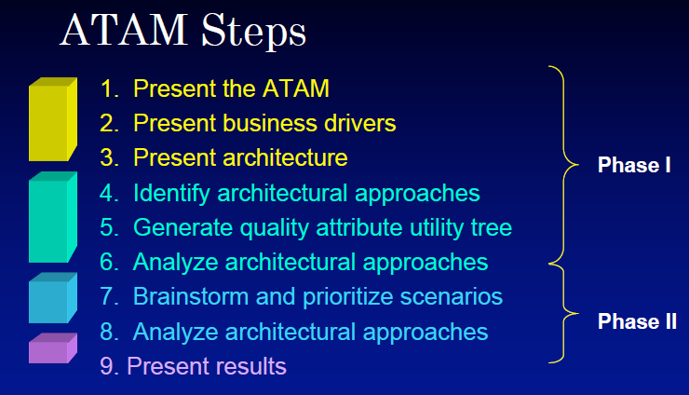

Slide 17
Tools and techniques to help
Checklists
Thought experiments
Analytical Models
Prototype and Simulations (my personal favourite)

Slide 18
Tools/ Techniques - 1
Checklists
Checklists have been proven as reliable tools for ensuring processes are correctly followed and specific tasks or questions are addressed.[^4] The
human mind cannot remember all the details that need to be considered in complex
designs or processes. Developing checklists provides a tool to capture
knowledge and ensure it is remembered and leveraged.
An example that can be used for validating part of a software architecture is
the OWASP Cheat Sheets - a set of checklists for black box testing and
security evaluation of web applications.[^3]
The Open Group has a Architecture Review Checklist at: <http://www.opengroup.org/public/arch/p4/comp/clists/syseng.htm>
Thought Experiments
Informal analysis performed by an individual or a small group. While thought experiments may lack the rigor that later methods (_Analytical Models_) provide, they can be an important method of exploring designs and quickly identifying potential issues that need to be further explored. Thought experiments also provide an environment more prone for discovering alternatives. Lacking the scripted narrative of an ATAM there is the opportunity to explore alternatives, free associate ideas and challenge assumptions.
[^3]: <https://github.com/OWASP/CheatSheetSeries/tree/master/cheatsheets
[^4]: <https://www.hsph.harvard.edu/news/magazine/fall08checklist/>

Slide 19
Tools/ Techniques - 2
Analytical Models
There exist a wide range of mathematical models that can be applied to address key architectural requirements.
- Markov and statistical models to understand availability
- Queuing and scheduling theory to understand performance
These models can provide key insights however there can be a steep learning curve to understanding the underlying theory and how to model the evolving software architecture with them.
Prototypes and Simulations
When fundamental questions cannot be adequately resolved by analysis methods a working prototype may be the only means to fully explore the decision space. Depending on what needs to be prototyped this can be an expensive task. However, it may be the only method of validating a design decision before fully committing to it.
Prototypes need to be approached with caution and a fundamental understanding of the end goal.

Slide 20
Class Activity (If time permits)
Run an ATAM for your project
Two “volunteers” from another team will serve as experienced architects for evaluation
Prepare “presentation” today – business drivers, architecture design, QA utility tree
Perform evaluation in the next class (step 6)
Document your results; risks, sensitivity points, tradeoffs, defects, overall assessment
Submit to the Activities/ATAM dropbox

Slide 21
ATAM Steps (Phase 1)
Explain the ATAM process
Present business drivers
  Domain context
  High level functions
  Prioritized quality attribute requirements and any other architecture drivers
Present architecture
  Overview
  Technical constraints
  Architectural styles and tactics used to address quality attributes with rationale
  Most important views

Slide 22
ATAM Steps (cont)
Identify places in the architecture that are key to addressing architectural drivers
  Identify predominant styles and tactics chosen
Generate QA utility tree – tool for evaluation
  Most important QA goals are high level nodes (typically performance, modifiability, security, and availability)
  Scenarios are the leaves
  Output: a characterization and prioritization of specific quality attribute requirements.
  High/Medium/Low importance for the success of the system
  High/Medium/Low difficulty to achieve (architect’s assessment)

Slide 23
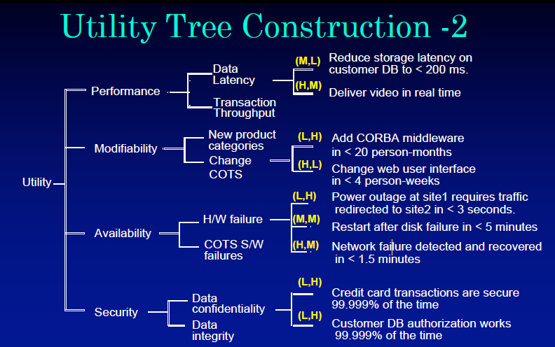

Slide 24
6. Analyze Architectural Approaches
Use the utility tree as a guide …
Evaluate the architecture design for the highest priority QA requirements, one QA at a time
The architect is asked how the architecture supports each one
Are the architecture decisions valid and reasonable?
Identify and record risks, non-risks, sensitivity points, tradeoffs, obvious defects
Findings are summarized – have the right design decisions been made?

Slide 25
7,8,9:Brainstorm, Re-analyze, Present
All stakeholders participate
Phase 1 results are summarized
Stakeholders brainstorm scenarios important to them
Generated scenarios are consolidated, compared to the utility tree, and prioritized.
The architecture analysis process is repeated
Summarize and present results ( and presumably adjust the architecture as a consequence)

